Slide 1

CLEVELAND POLICE
INTERNAL AFFAIRS INVESTIGATIONS

Slide 2
INTERNAL AFFAIRS STAFF
Superintendent Christopher Viland
Internal Affairs Unit
216-623-5346
cviland@clevelandohio.gov

Slide 3
INTERNAL AFFAIRS STAFF
Officer In Charge
Lt. Justin Cajka
Investigators
Sgt. Mitchell Sheehan
Sgt. Michael Schwebs
Sgt. Michael Matson
Sgt. Elberth Eggelmeyer
Sgt. Dalia Lopez
Sgt. Terry Lowther
Sgt. Jacob Simonelli
Administrative Assistant
LaTasha Vanzant
Notes:
Investigators required to be Sergeant rank based on interpretations of current policy language requiring that disciplinary specifications be presented by a supervisor.
Lt. Cajka has served 3 years total in internal affairs with the last six months as OIC. He has a Bachelor’s Degree in Criminal Justice/Homeland Security.
Sgt. Sheehan has 5 ½ years in internal affairs. He has over 16 years with the Cleveland Division of Police including numerous commendations including the Distinguished Service Medal.
Sgt. Schwebs is a 13 year veteran of the Division with almost 3 years service in internal affairs. He has a Master of Science in Criminal Justice Administration and specialized police leadership training from the OACP (PELC) and IACP (LPO).
Sgt. Matson started with the CWRU police department and transferred to the Division where he has been for the last 10 years. He was appointed to internal affairs in July of 2022.
Sgt. Lopez has been a sworn officer since 2018 after 17 years of experience as a dispatcher and chief dispatcher. She was appointed to internal affairs in October of last year.
Sgt. Eggelmeyer has 25 years experience with the Division including 9 years as a supervisor. He also is a recipient of the Distinguished Service Medal and was appointed to internal affairs in October of last year.
Sgt. Lowther has a Bachelor of Arts in Criminology and Associate’s in IT. He has experience with both the Lakewood and Avon Police Departments. He has 6 years experience with the Division and was appointed to the Division in October of last year.
Sgt. Simonelli, newest appointee, November of 2022 has 3 years experience with the Division. He has a dual Bachelor’s degree in Criminology and Sociology and several Divisional awards.

Slide 4
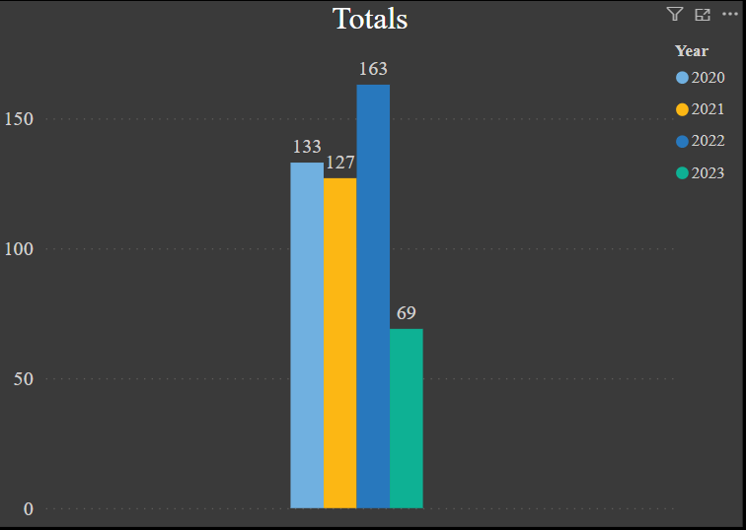
INTERNAL AFFAIRS
STAFFING v CASELOAD
2022 cases increased by 31% over 2021.
2023 cases are currently on pace to match 2022.
Staffing in 2022 dropped by over 20%.
Staffing continues to affect the entire CDP.

Slide 5
INTERNAL AFFAIRS
Organizationally
The Internal Affairs Unit is currently an operational unit within the Office of the Chief
The head of Internal Affairs is to be a qualified civilian, not a former member of the CDP
The head of Internal Affairs reports directly to the Chief of Police
Notes:
Pursuant to Settlement Agreement Paragraph 178 as amended (removing law enforcement officer proscription for the hiring of R. Bakeman).

Slide 6
INTERNAL AFFAIRS
Functions
Internal Affairs conducts objective, comprehensive and timely investigations of serious officer misconduct both criminal and administrative
Internal Affairs serves as the home of the Force Investigation Team that investigates all Level 3 Uses of Force in the Division
Responsible for other assignments as directed by the Chief

Slide 7
INTERNAL AFFAIRS
Misconduct NOT Investigated
Misconduct does not include minor infractions, or alleged violations of Division policy, procedure, regulations, orders or other standards of conduct that are immediately correctable through minimal intervention by a supervisor to prevent repetitive behavior. (Includes things like uniform violations, minor rudeness, failure to check equipment or WCS, traffic and parking infractions, motor vehicle damage
Repeat minor infractions cannot be handled through non-disciplinary means
Notes:
GPO 1.07.05 Internal Complaints of misconduct, definitions

Slide 8
INTERNAL AFFAIRS
External Misconduct NOT Investigated
External complaints received from any source are generally accepted and processed through the Office of Professional Standards
Unless the Reviewing Supervisor determines that an Internal Complaint of Misconduct (serious misconduct) or Criminal Misconduct has occurred
Notes:
GPO 1.07.04 Public Complaints of Misconduct
IA Manual Section VII D 2
Note that OPS has to refer criminal to IA

Slide 9
INTERNAL AFFAIRS
Referrals (not investigated by IAU)
Certain investigations may be referred outside the Division:
1. Violence in the Workplace
2. Sexual Harassment
3. EEOC violations
4. Outside LEA (conflict of interest)
5. City Law Department (including Ethics Officer)
6. City ADA Coordinator
Notes:
GPO’s 1.1.07, 1.1.08.1.1.09

Slide 10
INTERNAL AFFAIRS
Internal Referrals (not investigated by IAU)
Certain investigations may be referred back to the neighborhood District, or specific Bureau or Unit chain of command:
All allegations of misconduct involving Group I disciplinary violations
Appropriate Group II disciplinary violations that are not serious or complex, or do not raise concerns of public trust, and are not part of a pattern of misconduct
Notes:
IA Manual VII C1

Slide 11
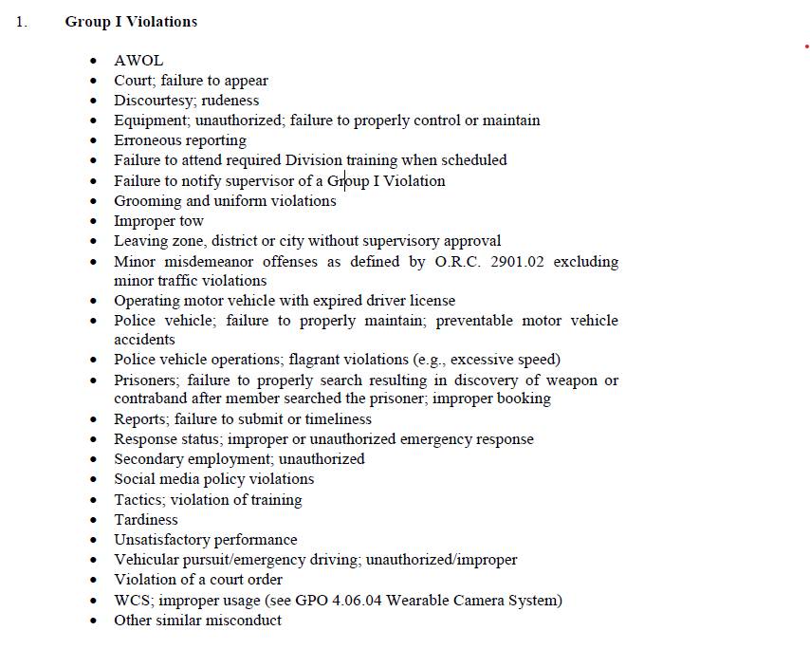
Examples of Group I Disciplinary Offenses
Notes:
Disciplinary Guidance GPO 1.07.06

Slide 12
INTERNAL AFFAIRS
Investigative Goals/Objectives
1. Objective, thorough, timely investigations
2. Establish factual truth
3. Protect the rights of everyone involved
4. Ensure that misconduct is brought to light for adjudication
5. Make formal recommendations regarding policy, procedures, training and equipment
Notes:
IA Manual I B & C

Slide 13
INTERNAL AFFAIRS
OPS Referrals
The Office of Professional Standards consists of investigators who are not sworn law enforcement officers
Therefore, any OPS investigation that have, as a component, a criminal misconduct aspect are mandated to be referred to IA
IA will follow the criminal investigation to its conclusion (prosecution or not) and then the case will be returned directly to OPS
Notes:
IA Manual VII E

Slide 14
INTERNAL AFFAIRS
Investigative Procedures + Key Points
IA fully investigates any conduct that would support a criminal charge/conviction, no matter whether the crime is actually charged, or is charged and dismissed or not convicted.
Non-conviction is not considered in evaluating whether the conduct occurred and whether the conduct violated law or policy
Notes:
IA Manual VIII B
Examples of Rule 29, other dismissals, charged administratively anyway (DV)

Slide 15
INTERNAL AFFAIRS
Investigative Procedures + Key Points
Retaliation, intimidation, coercion or any other adverse action against anyone reporting misconduct is prohibited and grounds for discipline up to and including termination
Notes:
IA Manual VIII D

Slide 16
INTERNAL AFFAIRS
Investigative Procedures + Key Points
Investigators locate and formally interview all known witnesses
Investigators canvass the area for witnesses and any audio or video recording of the event by private parties or third party recording devices
Interviews are recorded
Notes:
IA Manual VIII E-G
Might include recording a witnesses cell phone video, or requesting to download/copy/forward
(Grace / Gulak OIS)

Slide 17
INTERNAL AFFAIRS
Investigative Procedures + Key Points
Investigators will NOT prefer an officer’s statement over any non-member’s statement
Witness/Complainant statements will not be disregarded based on any criminal history
Witness statements will not be disregarded solely because of a relation to the complainant
Notes:
IA Manual XI E

Slide 18
INTERNAL AFFAIRS
Investigative Procedures + Key Points
If the person involved / complainant is convicted of any offense related to the incident, this is by itself NOT a reason to discontinue an investigation or determine whether an officer engaged in misconduct
Notes:
IA Manual XI G
Not uncommon for officers to face discipline even when the complainant is in jail or goes to jail

Slide 19
INTERNAL AFFAIRS
Bifurcation of Investigations
Criminal investigations involve a person’s 5th Amendment rights against self-incrimination
This includes any statements or documents made as part of their regular duties
Therefore, the criminal investigation cannot consider or obtain certain evidence
This requires IA investigations to be bifurcated into two separate parts

Slide 20
INTERNAL AFFAIRS
Bifurcation of Investigations
Bifurcation may occur by having separate Unit or investigator for each investigation (Criminal v Administrative)
Bifurcation may occur by conducting the criminal prior to completing the administrative (In these cases, there is an overlap)

Slide 21
INTERNAL AFFAIRS
Bifurcation of Investigations
Public employee rights under
Garrity v. New Jersey 385 US 493 (1967)
Require formal Garrity warnings and protections
Notes:
IA Manual IX D

Slide 22
INTERNAL AFFAIRS
Additional Employee Rights
National Labor Relations Board v. Weingarten (1975)
Any interview that employee believes may result in discipline
Employee can choose any representative to be present
Employee must assert these rights

Slide 23
INTERNAL AFFAIRS
Investigations of Past Members
IA does not investigate members no longer with the Division (no jurisdiction)
If a member leaves the Division during an investigation, the investigation is taken to its conclusion both criminally and administratively
Any administrative portion is simply completed for the formal record to be used in potential rehire situations or to present in records requests for background information
Notes:
IA Manual Section X

Slide 24
INTERNAL AFFAIRS
Timelines
Generally criminal investigations are to be completed in 120 days
Generally administrative investigations are to be completed in 30 days
Extensions can be granted by the Chief
No investigations abandoned because timelines are not met
Notes:
IA Manual Section XV

Slide 25
INTERNAL AFFAIRS
Burden of Proof
Internal Affairs investigations are assessed using a “Preponderance of Evidence” standard
Significantly lower than “Proof Beyond a Reasonable Doubt”
But significantly higher than “Probable Cause”
Notes:
IA Manual Section I D 7
refers to a determination, based on the greater weight of the evidence, that it is more likely than not that the conduct is inconsistent with federal, state, or municipal law, CDP rules, regulations, policy, procedure, or training has occurred or has not occurred.

Slide 26
INTERNAL AFFAIRS
Dispositions
1. Sustained – Conduct occurred and it was a violation
2. Not Sustained – Insufficient evidence to prove or disprove a violation
3. Unfounded – Allegation is false or did not occur
4. Within Policy – Use of Force was consistent with law and training
5. Referred to OPS
6. Closed – Retired/Resigned
7. Completed – Use of Force by an outside agency
Notes:
IA Manual Section XVII

Slide 27
INTERNAL AFFAIRS
Use of Force Investigations
Conducted by the Force Investigation Team (FIT)
Comprised by members of IA, the Homicide Unit, the Crime Scene and Records Unit, and OPS as supplemented by members of the Training/Academy Unit
Notes:
FIT Manual II A 1 and VI A

Slide 28
INTERNAL AFFAIRS
FIT Required Responses – Level 3 Uses of Force
1. All incidents involving use of Deadly Force
2. Serious physical harm, result in death or likely to result in death, or hospital admission
3. Death of any person in custody
4. Loss of consciousness
5. Any neck hold
6. Any strike to the head with a hard object (includes closed fist)
7. Any criminal misconduct
8. More than 3 applications of CEW (Taser)
9. CEW application longer than 15 seconds
10. Lower level uses of force on handcuffed individual
11. Any other assignment from the Chief
Notes:
FIT Manual IV B
Size and composition of the response is determined by the Bureau of Special Investigations Commander in consultation with the Internal Affairs Superintendent FIT Manual Section III A 3 and Section IV B 1

Slide 29
INTERNAL AFFAIRS
FIT Required Responses
The FIT also responds to and investigates any critical firearms discharge:
Discharge of a firearm including accidental discharges, discharges at animals not including euthanasia, discharges where no one is struck and discharges by members of outside agencies
All other lower level uses of force are investigated by the supervisory chains of command
Notes:
GPO 2.01.01 UOF definitions
GPO 2.01.07 FIT
Decree paragraphs 94-109

Slide 30
INTERNAL AFFAIRS
Use of Force Investigations
FIT investigations also required to be bifurcated
In effect, there are 4 different investigations going on:
1. Criminal Conduct by Suspect
2. Use of Force Inquiry
3. Administrative Invest of CDP Member(s)
4. Criminal Conduct by Officer(s)
Notes:
FIT Manual Section V A
FIT Manual Section IV A

Slide 31
INTERNAL AFFAIRS
Use of Force Investigations
Currently, the Division operates under a Memorandum of Understanding with the Cuyahoga County Sheriff’s Department
The Sheriff’s Department criminally investigates any use of force resulting in the actual or anticipated death of another
FIT conducts parallel administrative investigations
Notes:
Decree paragraph 117
Sheriff’s MOU

Slide 32
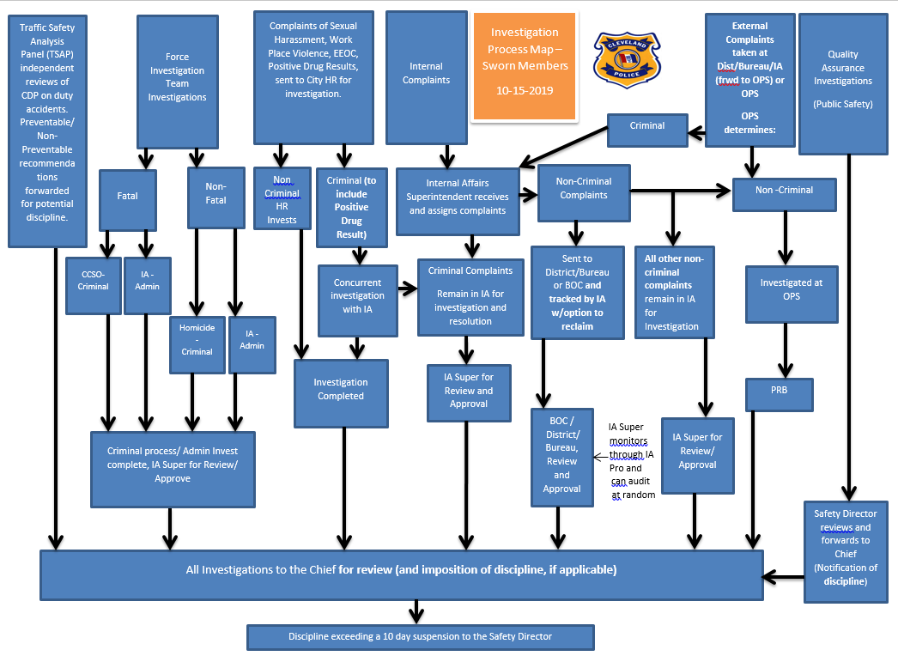

Slide 33

Media Coverage

Slide 34
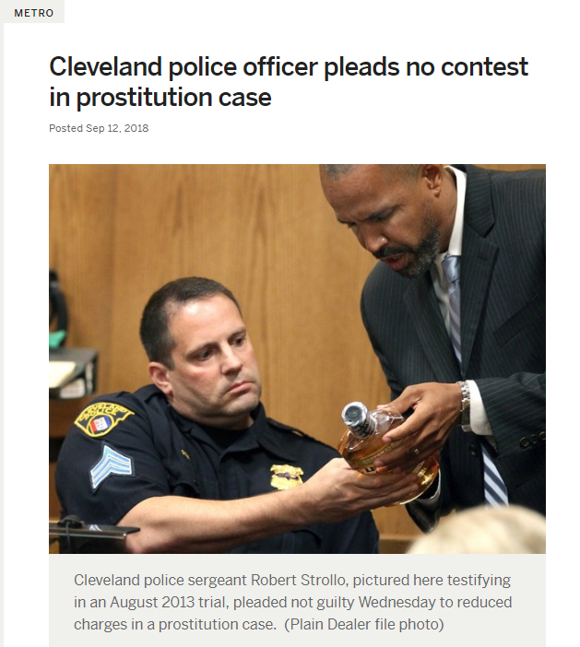

Slide 35
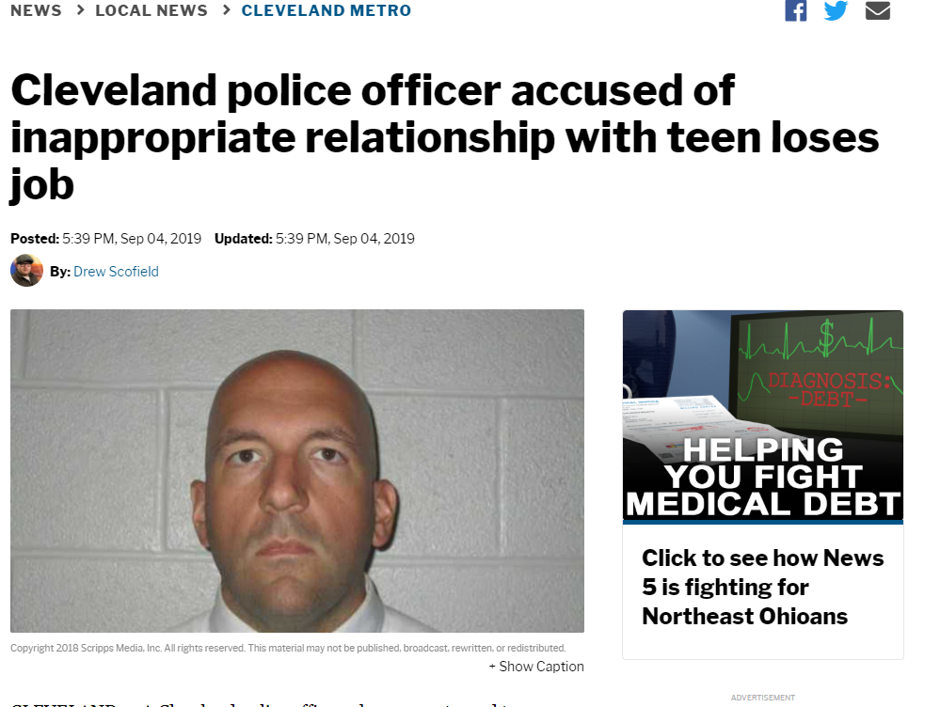

Slide 36
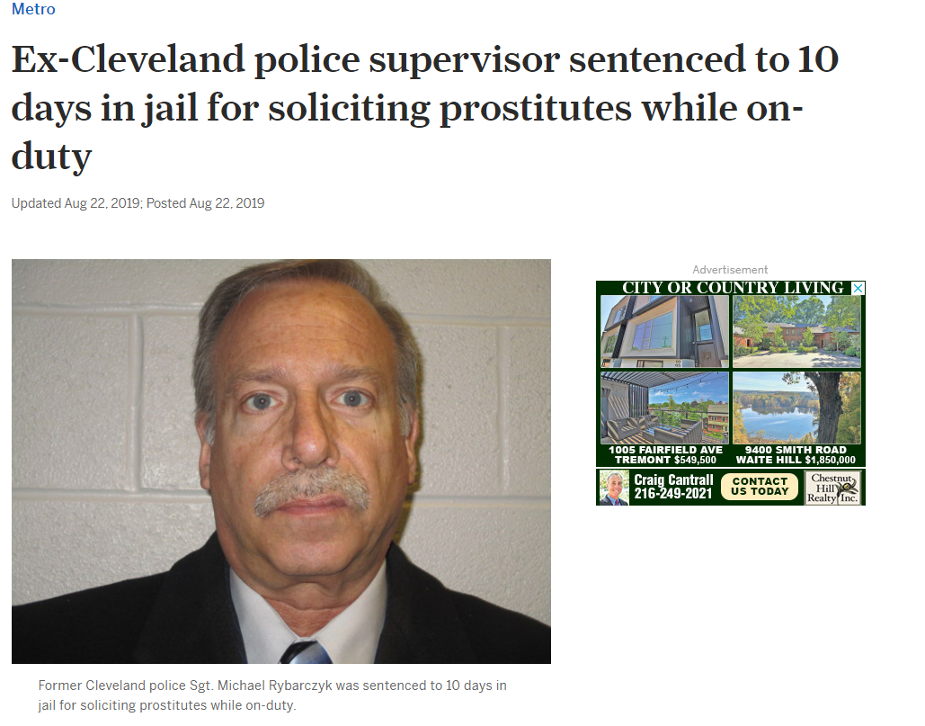

Slide 37
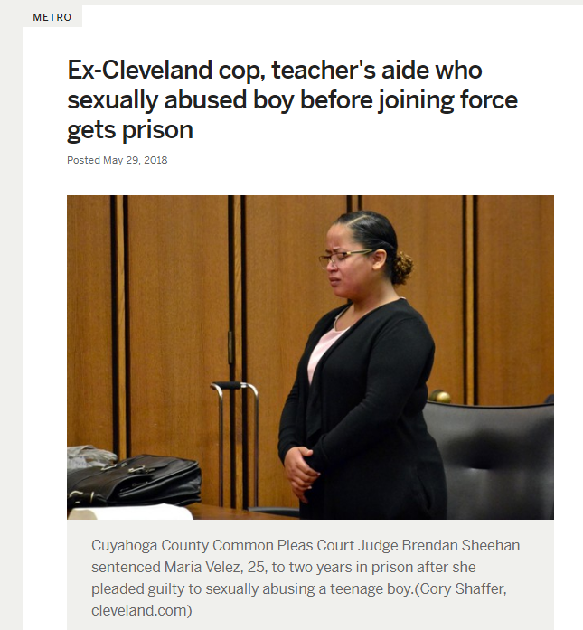

Slide 38
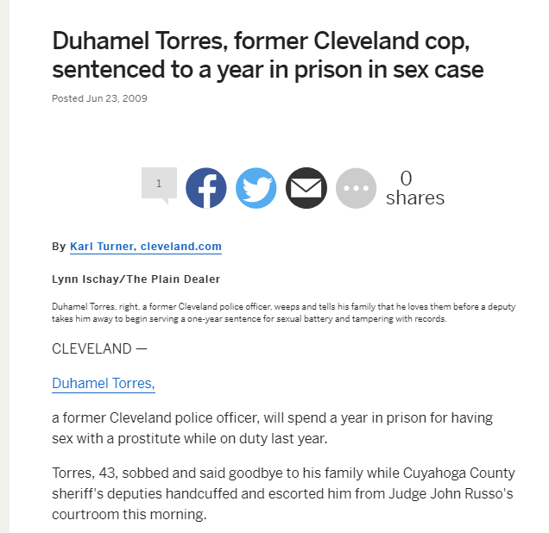

Slide 39
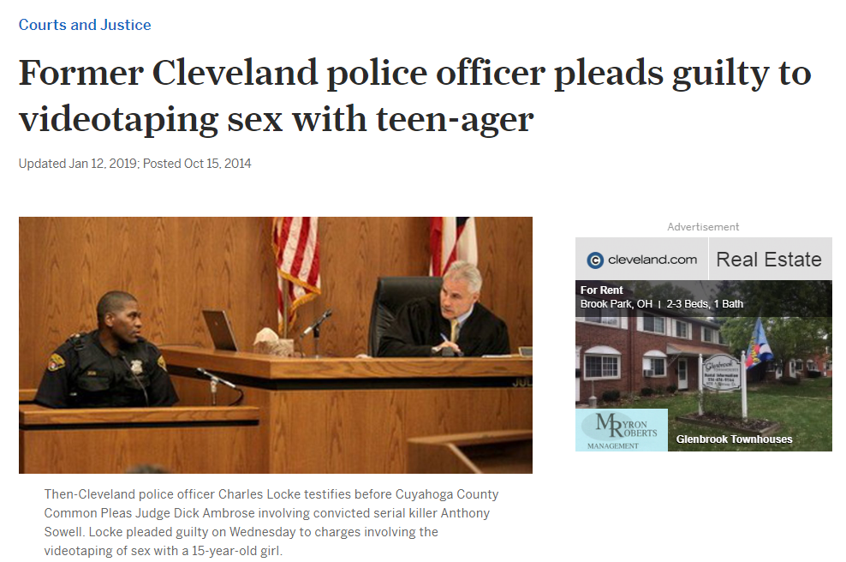

Slide 40
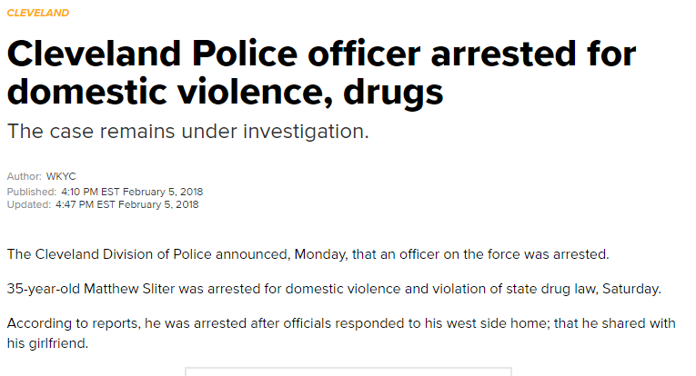

Slide 41
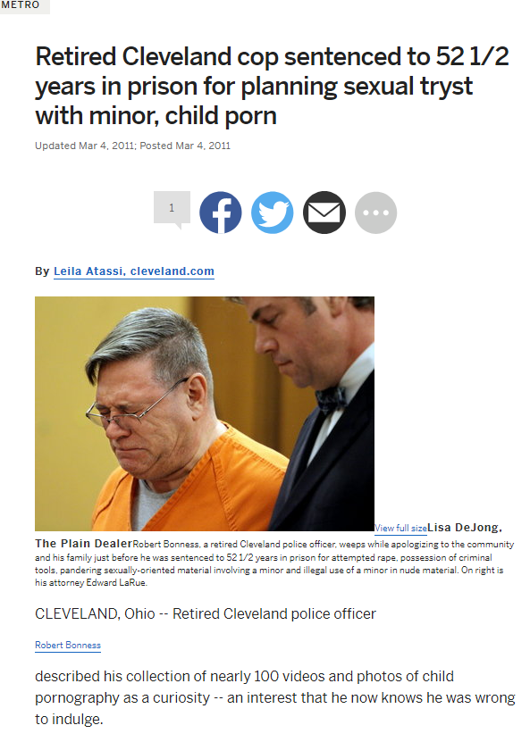

Slide 42
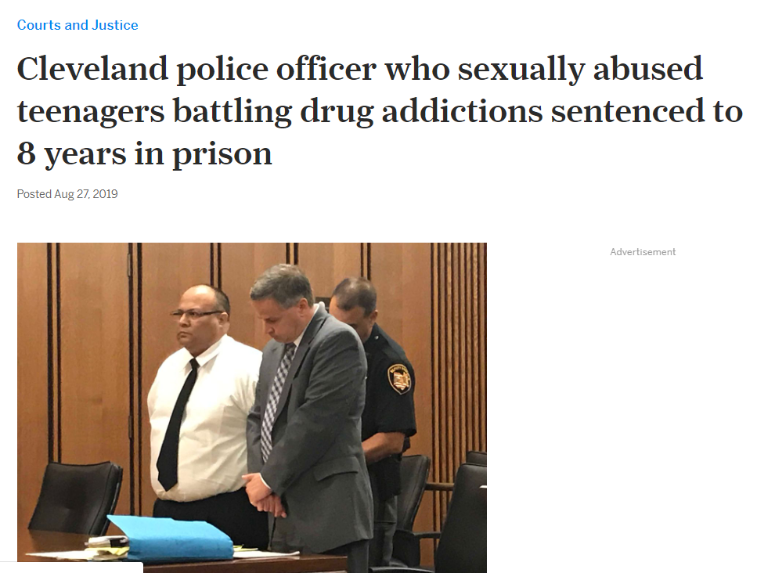

Slide 43
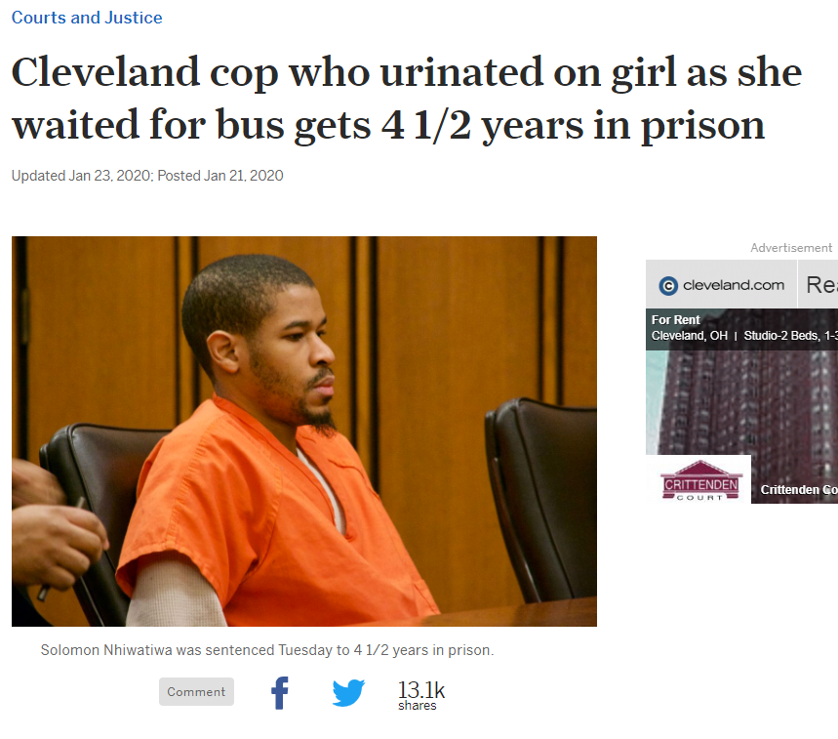

Slide 44
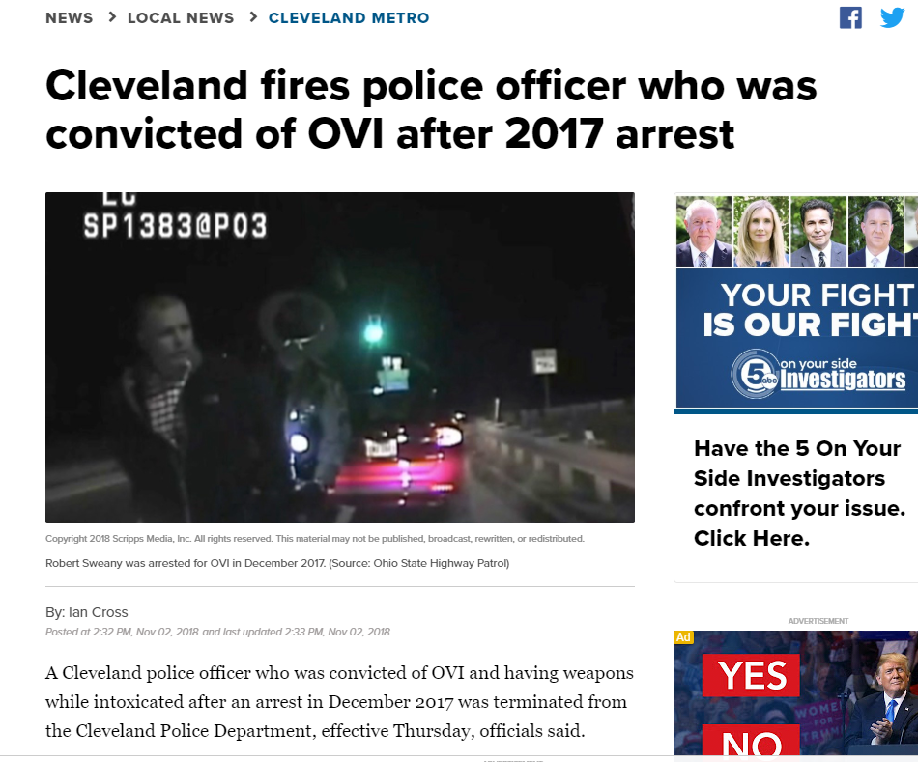

Slide 45
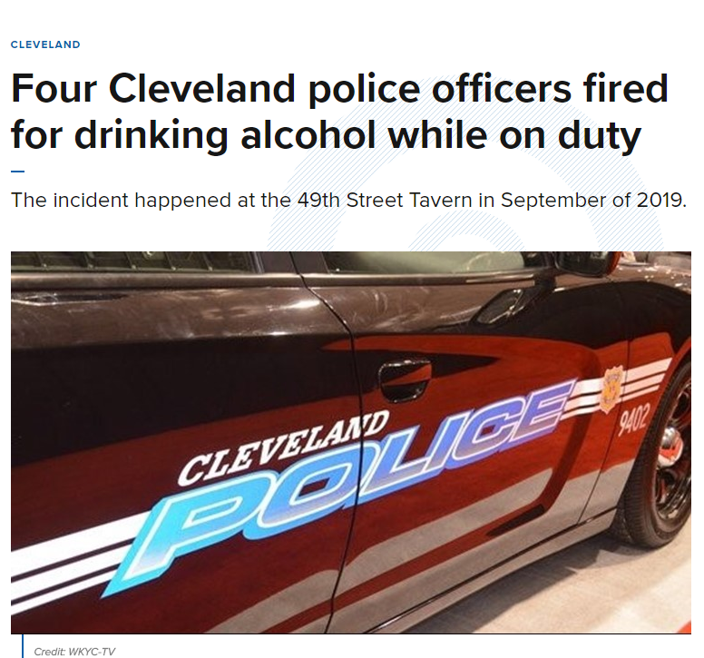

Slide 46
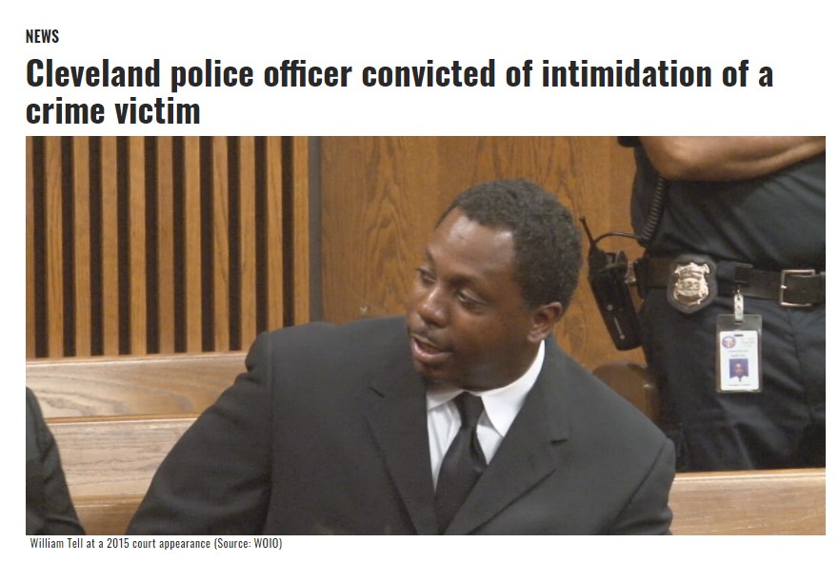

Slide 47
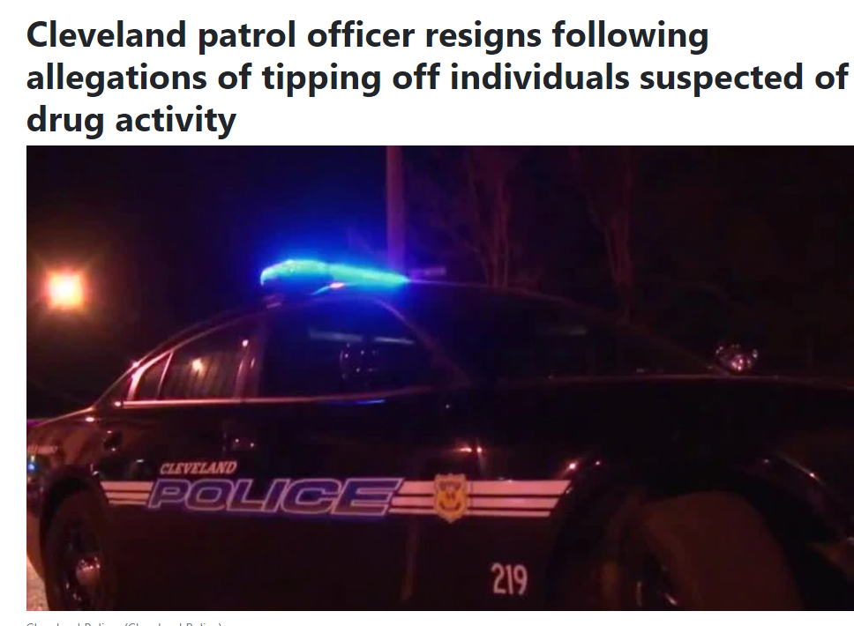

Slide 48
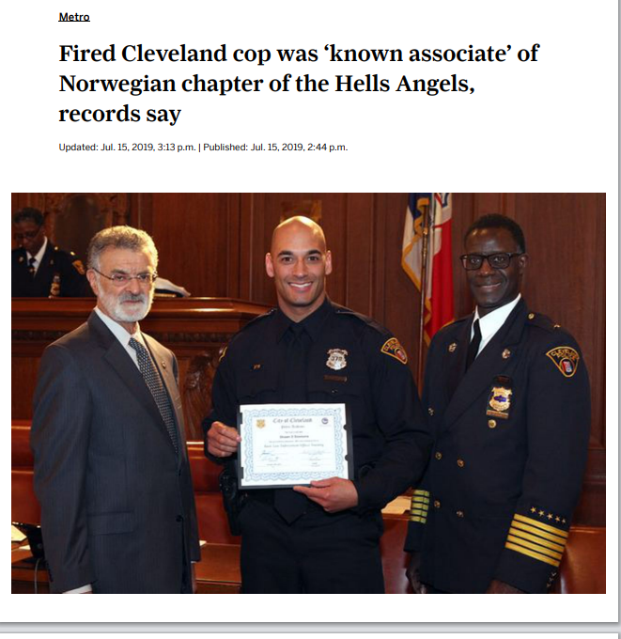

Slide 49
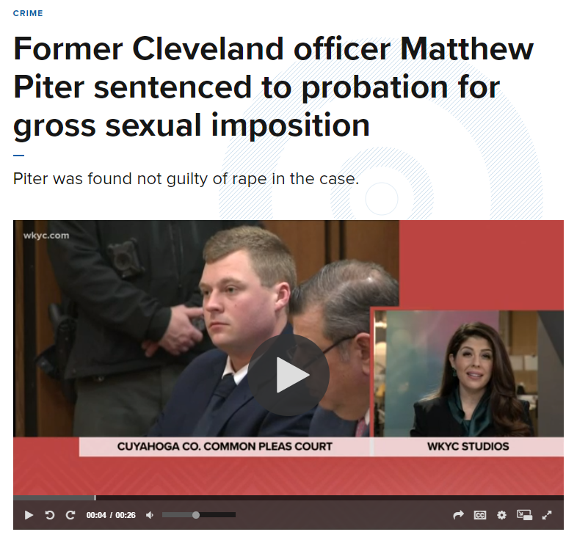

Slide 50
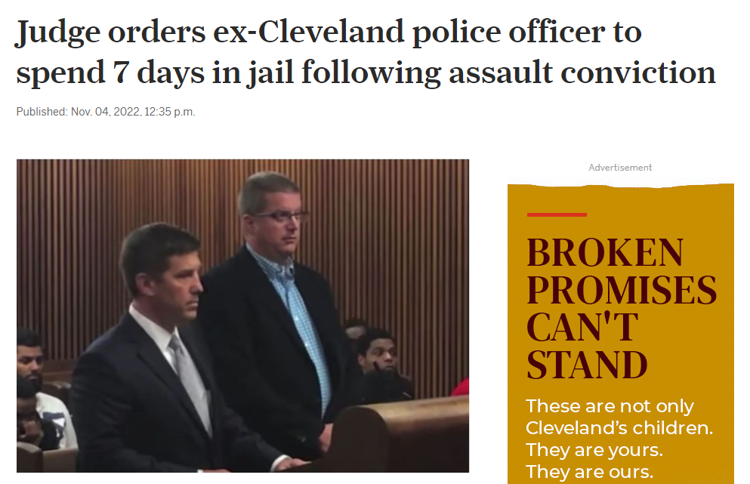

Slide 51
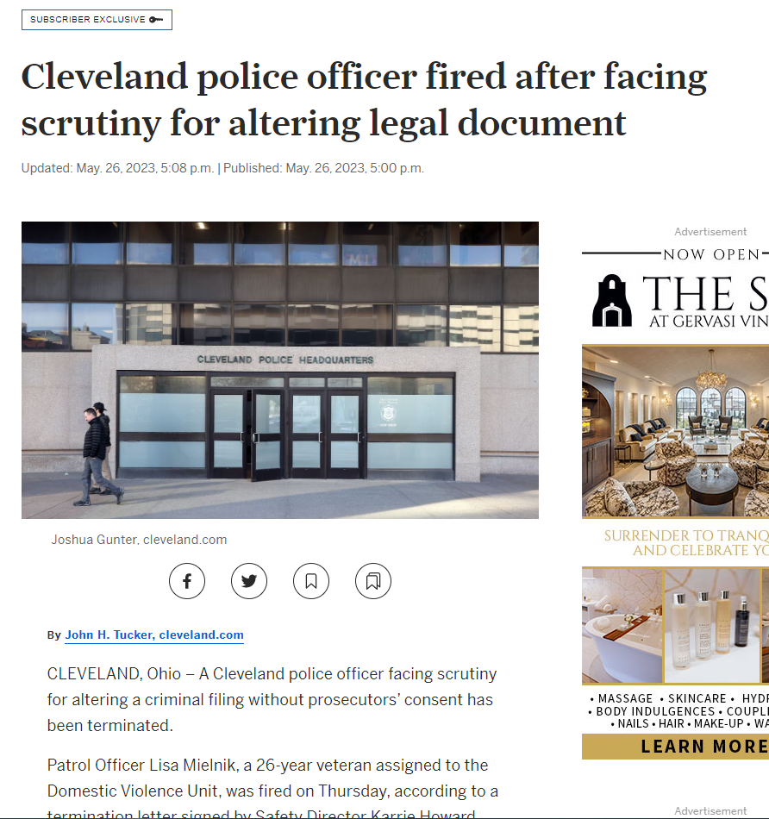

Slide 52
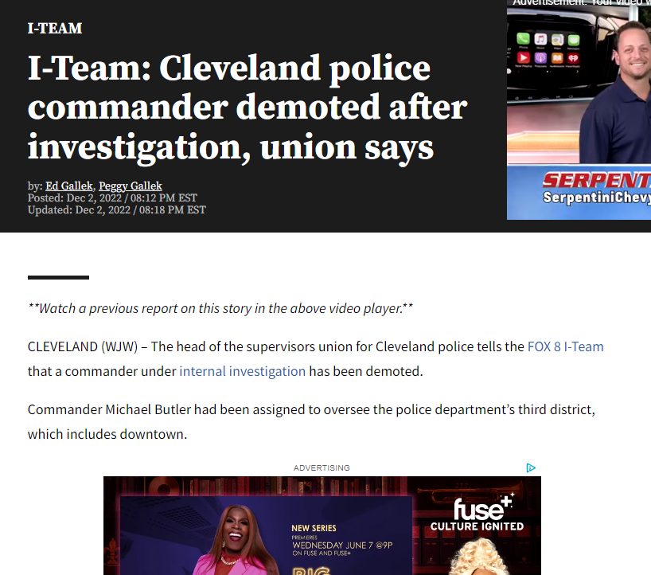

Slide 53
Questions?

